Slide 1

Image Style Transfer using tensor flow
Sri Manjusha Tella

Slide 2

Contents
Main Idea
Loss Functions
Results
Conclusion

Slide 3


Main Idea of Style Transfer Algorithm
Layer 0
Layer 1
Layer 2
Layer 3
Classifier
Content Image
Style Loss
Style Loss
Content Loss
Style Image
Output Image
Gradient Matrix

Slide 4
Content Loss function

Slide 5
The loss function of the normal image tries to minimize the loss difference of the features that are present in the normal image and that of the mixed image which as a result produces the same content (edges and highlights) of the normal image into the mixed image.

Slide 6
Style Loss Function

Slide 7
The style image loss function tries to minimize the loss difference between the matrices dedicated to both the style image and mixed image respectively. This matrix is used to transfer the texture features of the style image into the mixed image.

Slide 8
Total Loss Function
This total loss equation is essential for letting us know how to produce a good stylized image..

Slide 9
Results
Example 1

Slide 10
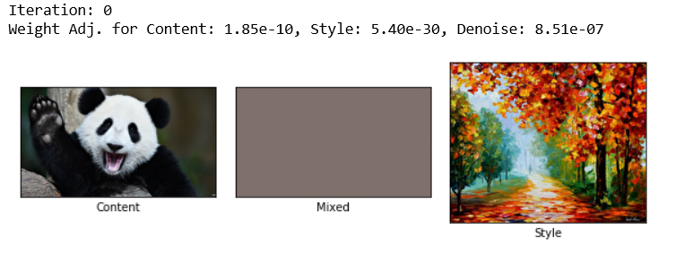
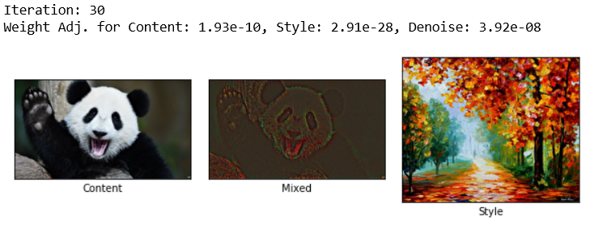
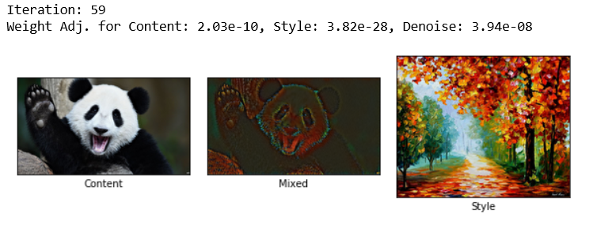

Slide 11
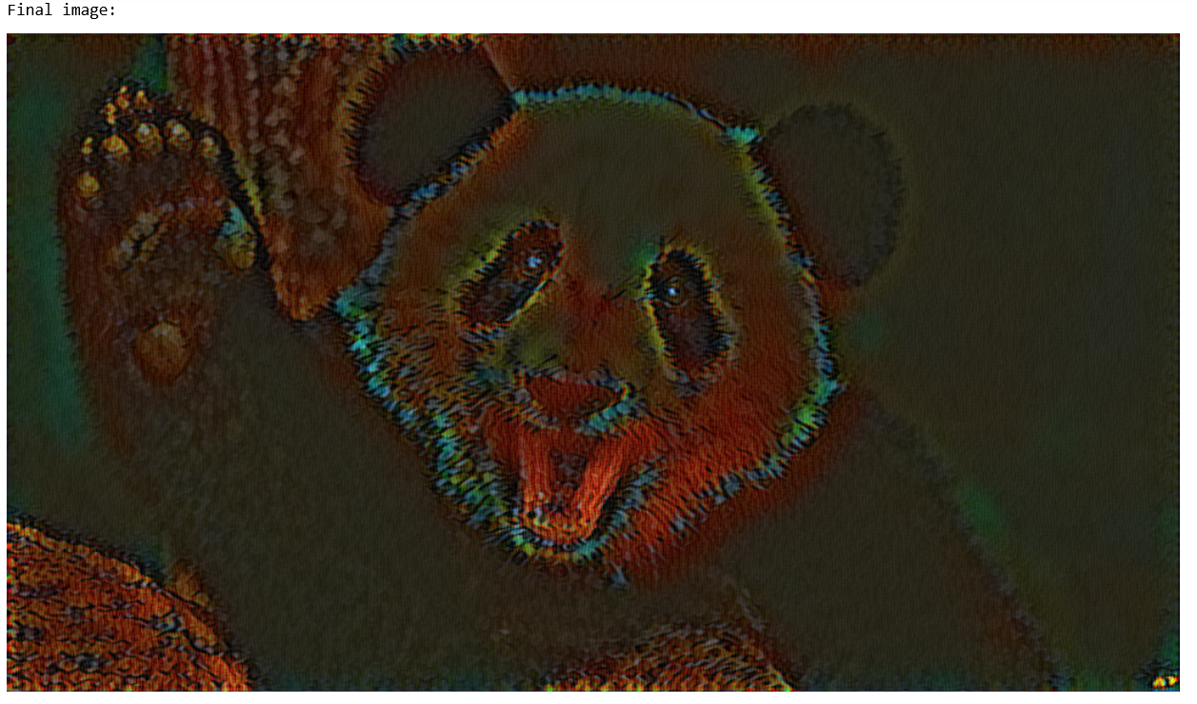

Slide 12
Results
Example 2

Slide 13
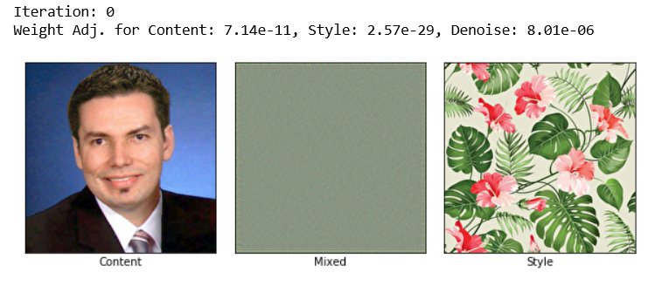
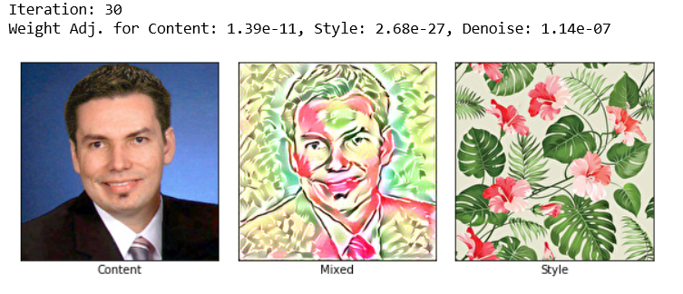

Slide 14
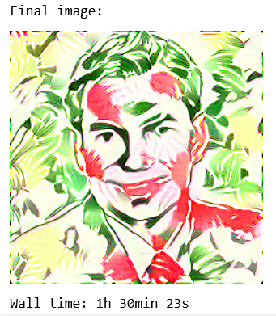
After 1000 iterations . . .

Slide 15
Conclusions
This method works pretty well.
It produces a mixed image combining the content image and style image.
Very much useful in understanding the convolution neural network, style and content image appearances.

Slide 16


